Slide 1
Signature detection & Recognition
Praveen Vijayan
Official Email : praveen.vijayan@tcs.com
Personal Email : praveenkottayi@gmail.com

Slide 2
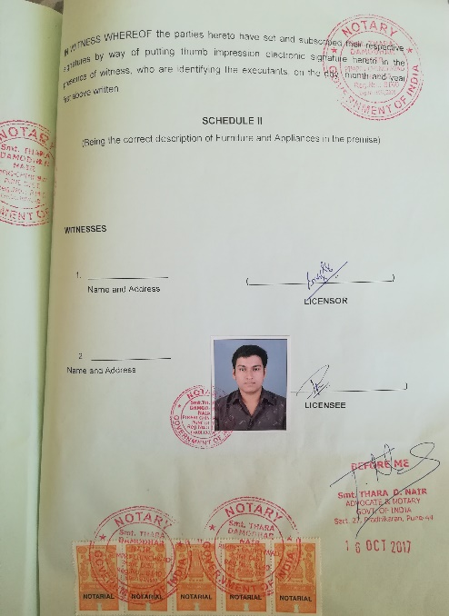
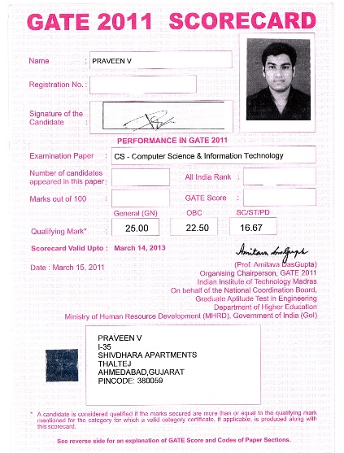
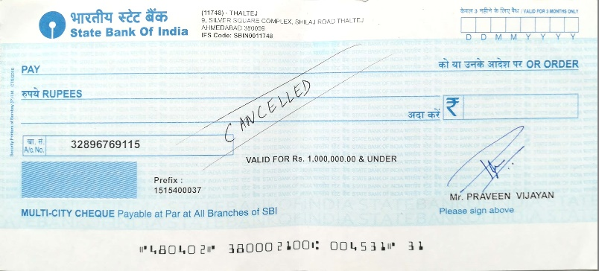
WHY part of Signature detection & Recognition
Automated
Faster
Accurate
Where Scenarios
Cheque clearance
Legal document processing
Invoice processing
Bill processing
Anywhere in document
Multiple interests
Tag automatically
Any doc size / Font / Color / language
Any signature color / font

Slide 3
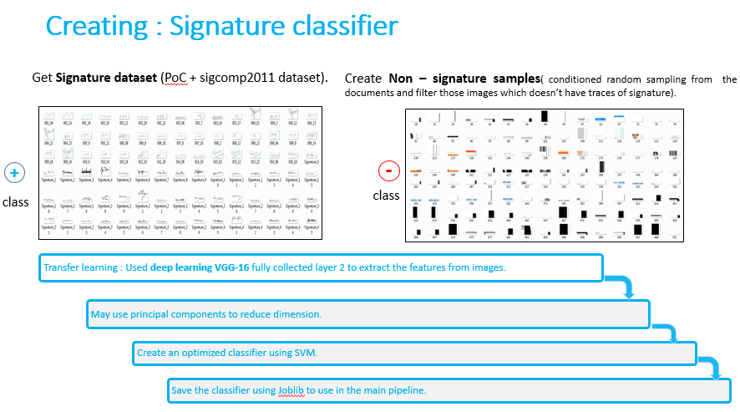
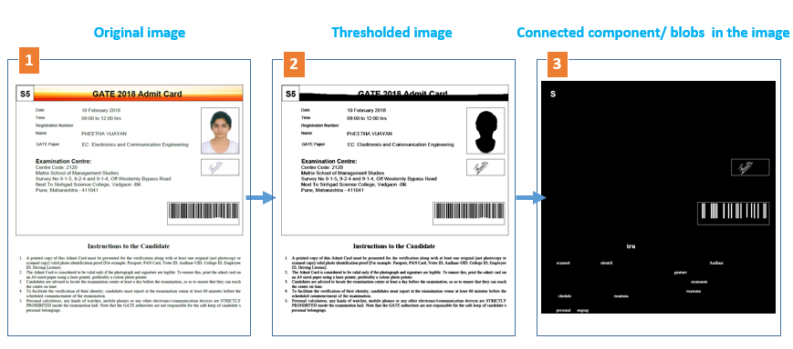
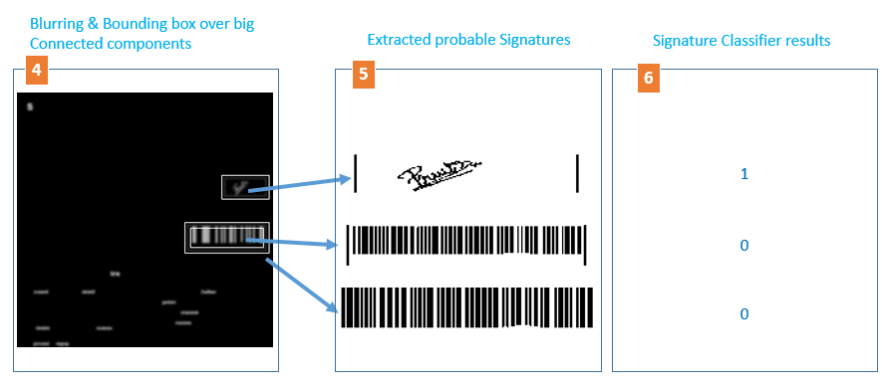
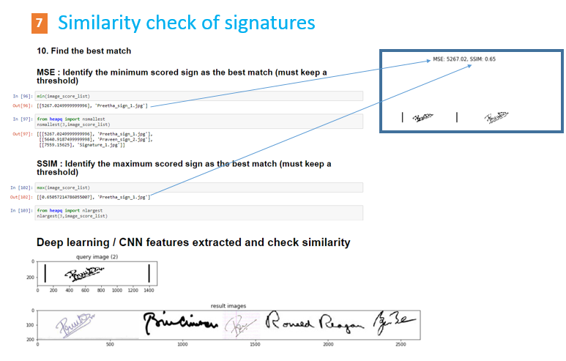
HOW part of Signature detection & Recognition
#
#
0
#
Most similar signatures
7

Slide 4
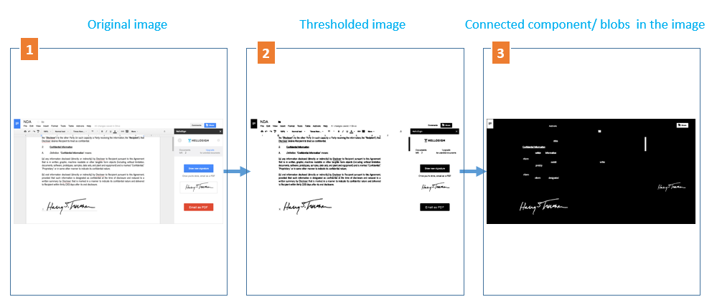
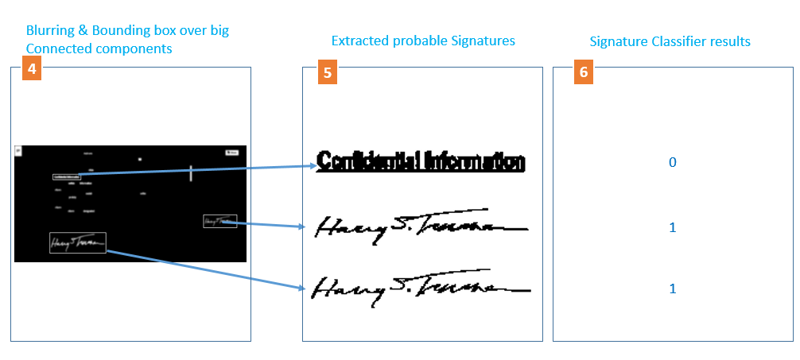
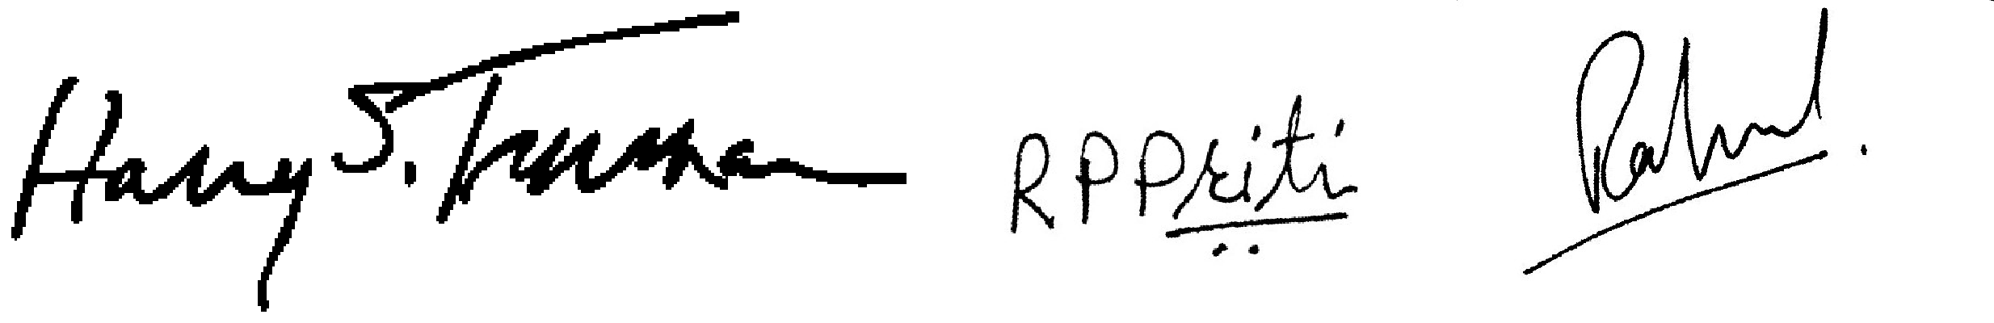
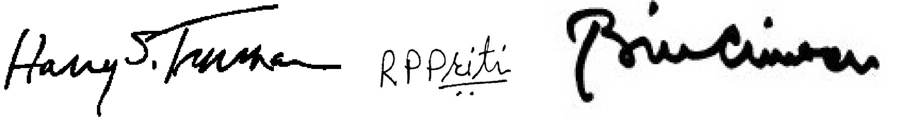
One more example
Similar Signatures based on similarity:
[0.0, 50.23, 50.58]
Similar Signatures based on similarity:
[32.57, 50.23, 55.26]

Slide 5
Pros of this method
Further Improvements
Instead of going for a cascading scanning of probable signatures with a Classifier, preferred image processing method, which is way faster to find ROIs.
Created dataset for non-signature examples by conditional random sampling from the documents and removing those containing traces of signature.
Hence further reducing the number of probable signatures for comparison with Signature database.
Used Deep learning(VGG-16) to capture better features that can distinguish signatures.
At present system is designed in such a way that False positive is better than False negative. Because missing a valid signature may end up not getting tagged to the right person. Even if its false negative, the last stage of signature comparison would filter the wrong ones.
Need more data for Signature and non-signature set
Padding the probable signature part instead of direct scaling
Extracting better features from image
Dynamic thresholding, blurring

Slide 6
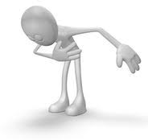
Thank you

